Slide 1
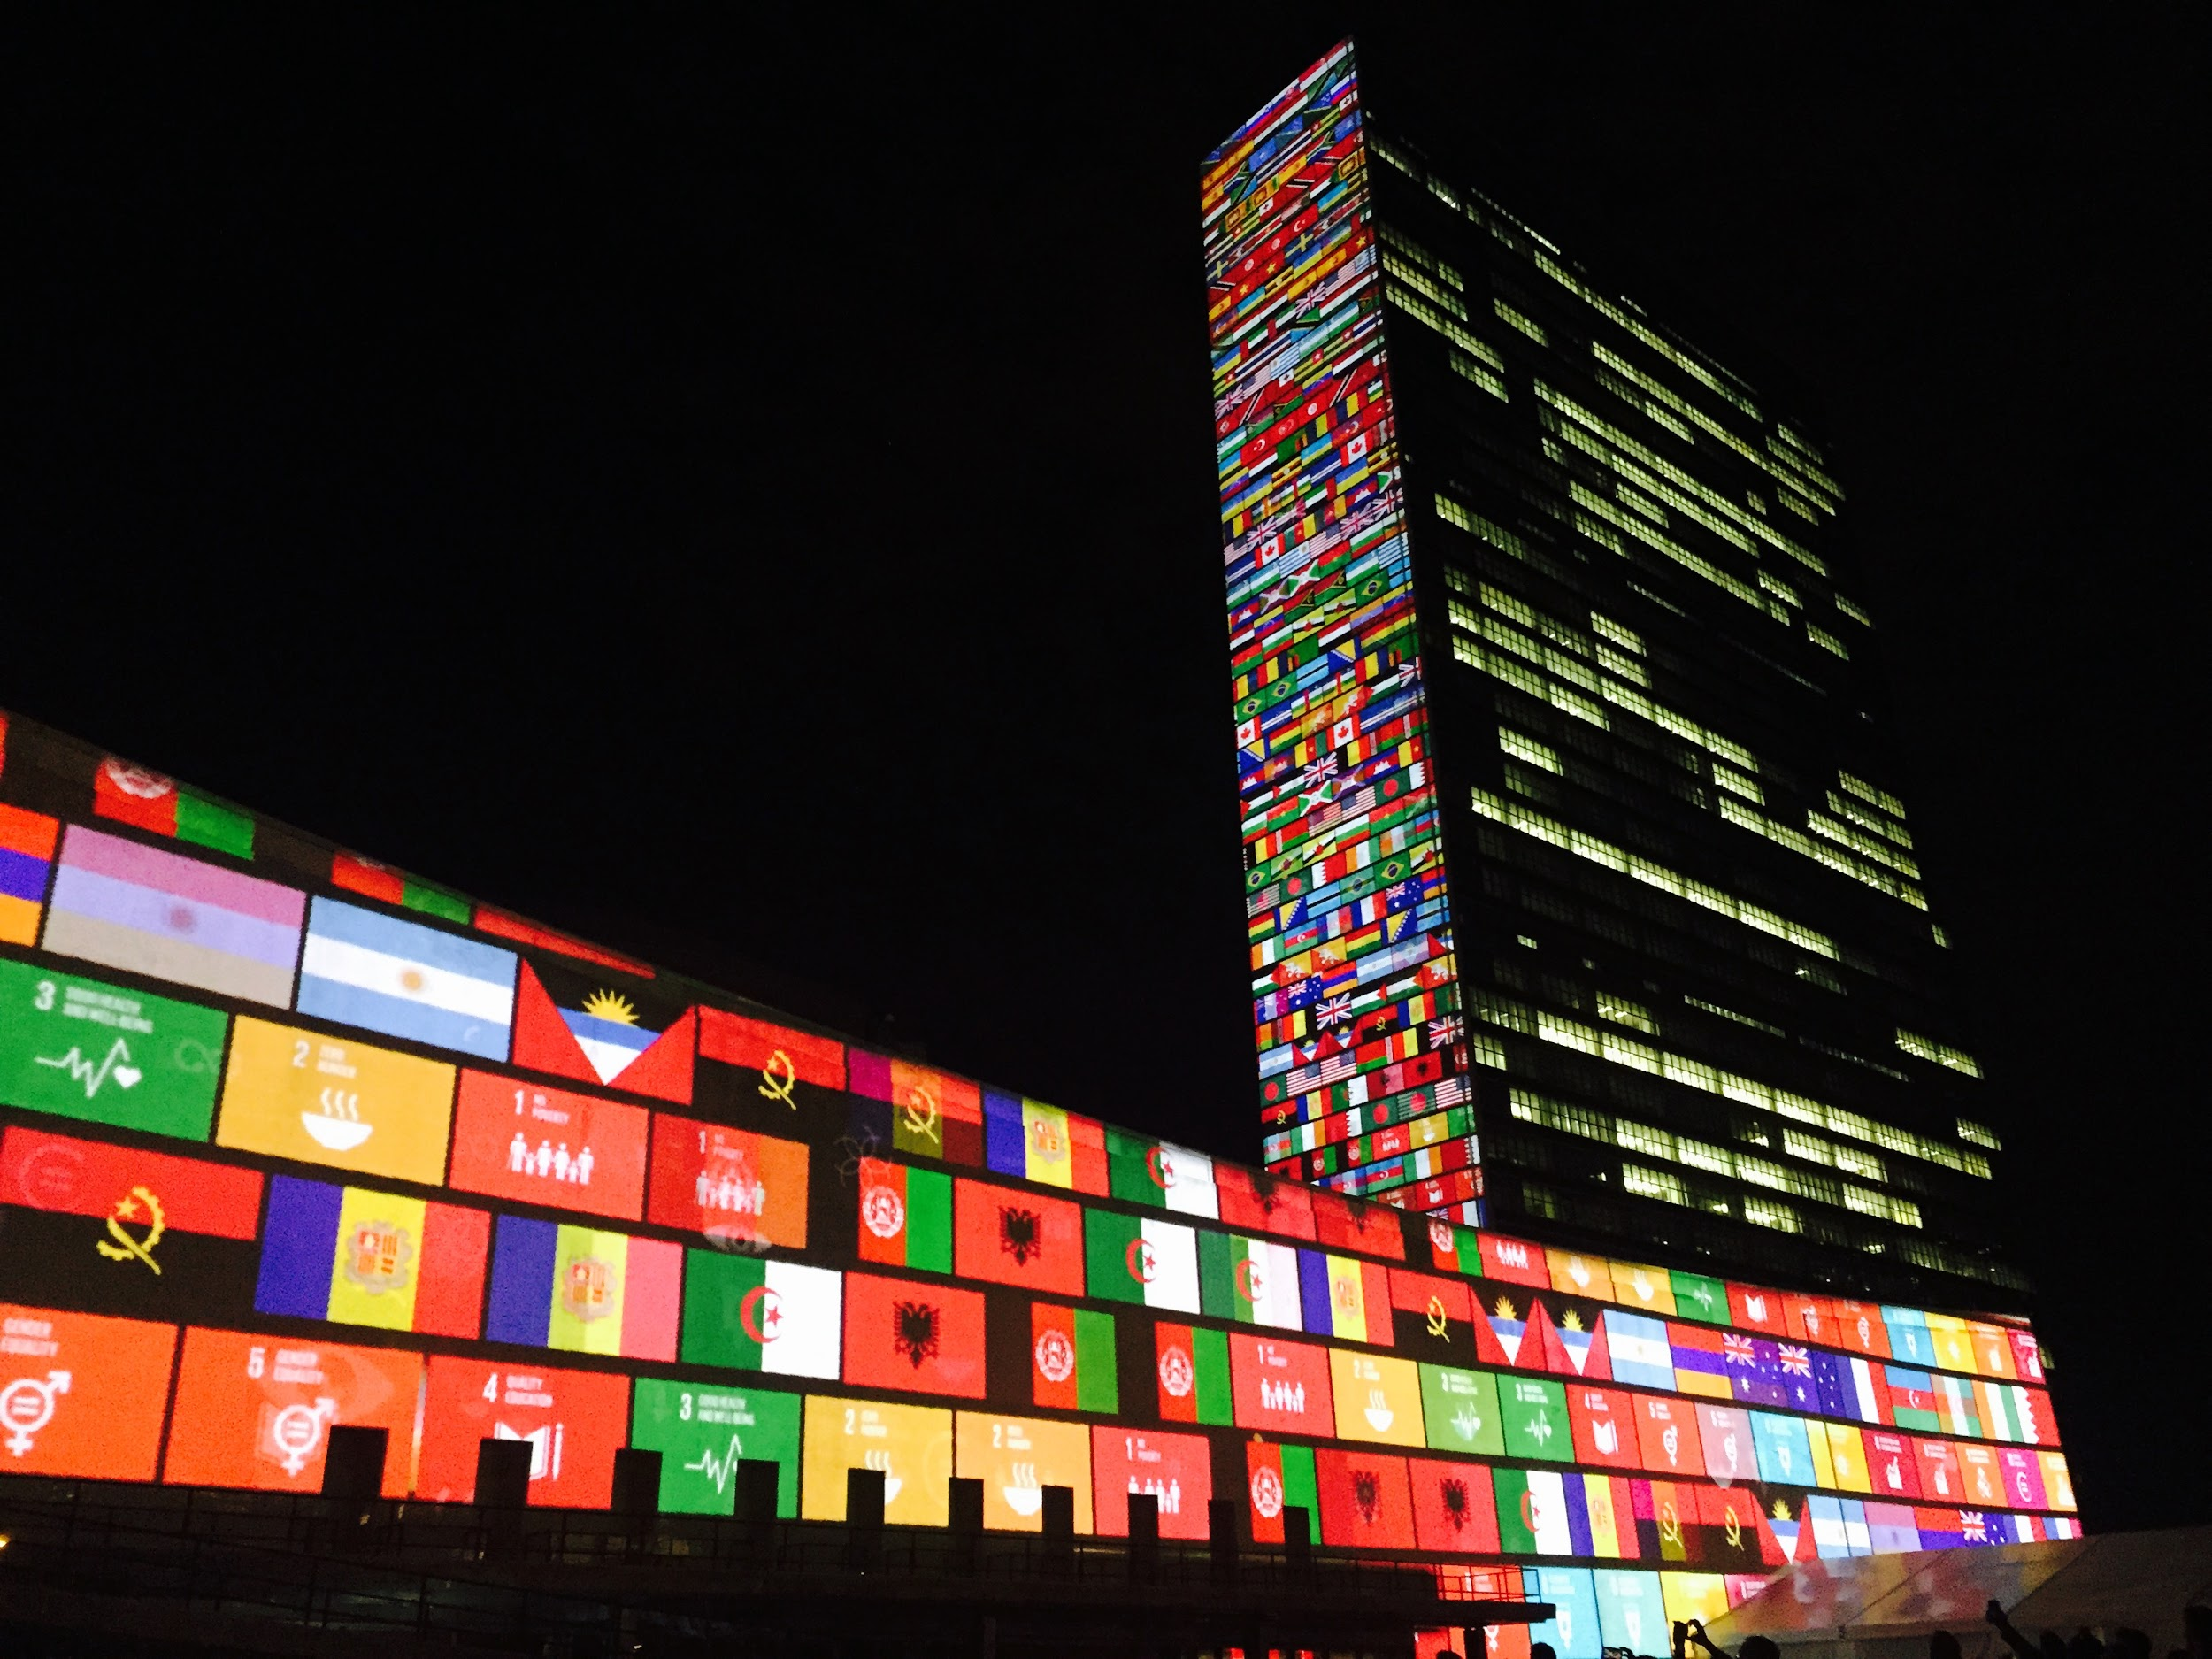

The Result
of the
Civic Mirror Experiment
Owen Brake
Notes:
The ultimate lesson we can derive from this experiment we have all participated in is that of the effectiveness of leftist ideologies. We have all learned of the effects of crony capitalism and unchecked power, that is the true message that we have learned.

Slide 2
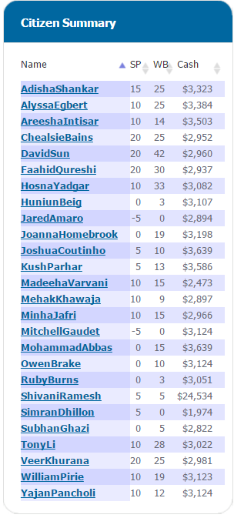

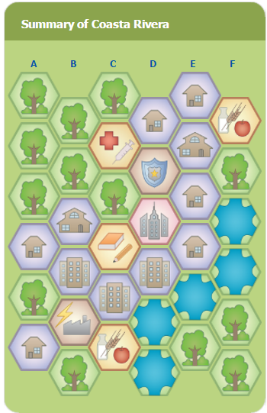
What we Created
Notes:
Now we will review what we have created in this game.

Slide 3
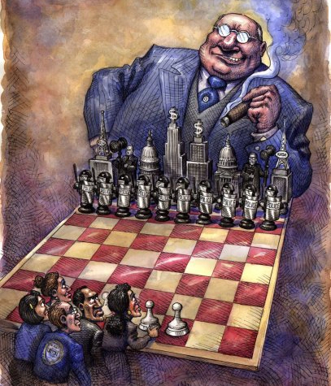

Oligarchy
Masked as a
Liberal democracy
Notes:
The country we have created is essentially an oligarchy. A small portion of wealthy and therefore powerful people control the government. The election was a sham, if there are no checks and balances then the people essentially elected a dictatorship.

Slide 4
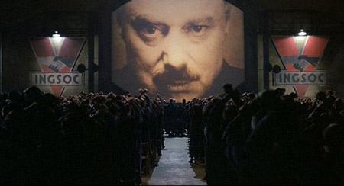
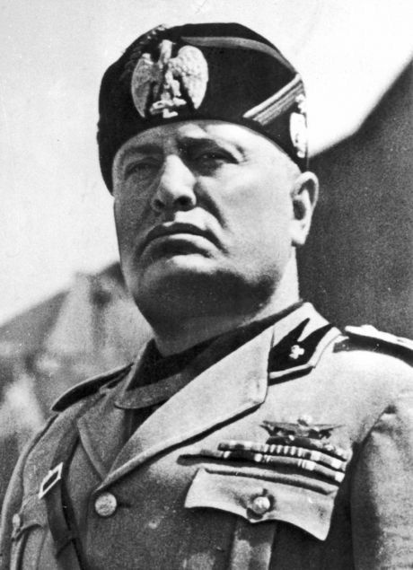
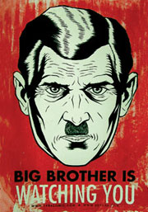
Totalitarian Government
Notes:
In this game we also allowed the government to gain a significant amount of power. The government rigged the referendum for judge and lied about the vote, to create public approval. They blackmailed and threatened many political opponents to reach and hold onto power

Slide 5
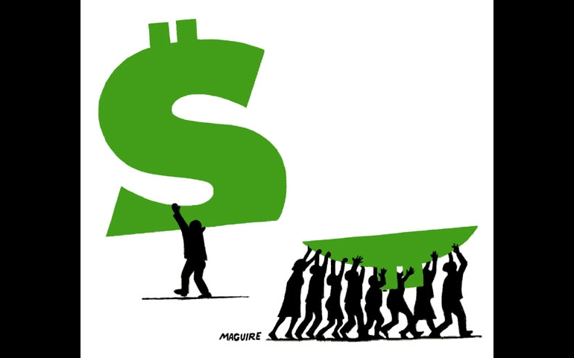


Relationship to Modern Canada
Notes:
The country we have created is very similar to Canada and many western democracies. We have a liberal democracy, a strong capitalist system except there is one difference the citizens of Coasta Rivera recognize the oligarchy, they recognize that there is a problem when not all people are born equally. Canadians are blinded by patriotism and the false promises of politicians believing that there is no other option. A final note is that Canada is not an authoritarian regime, the people techinically have a choice in Canada of their leader however in Coasta Rivera there are nearly no democratic features there is one election however you elect a dictator.

Slide 6
Issues, Lessons and Solutions
Notes:
Now some of the Issues of the country we have created Coasta Rivera

Slide 7
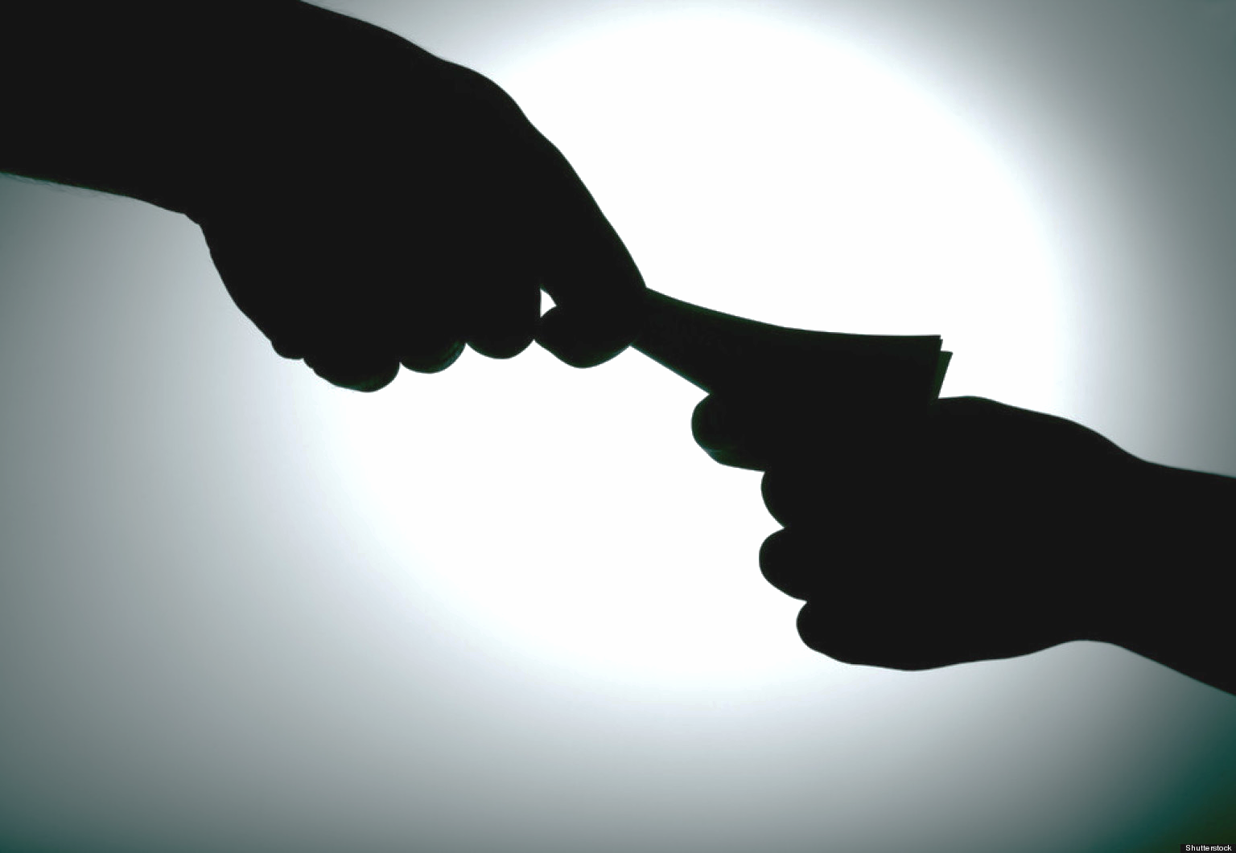
Greed and Abuse of Power
Notes:
It is no secret that the government of Coasta Rivera had an issue of benefiting politicians over constituents. You can see that the prime minister has $25k about ¼ of the total economy. David Sun and Chealsie Bains both has some of the highest WB and SP points. We saw the true effects of having a system without checks and balances.

Slide 8
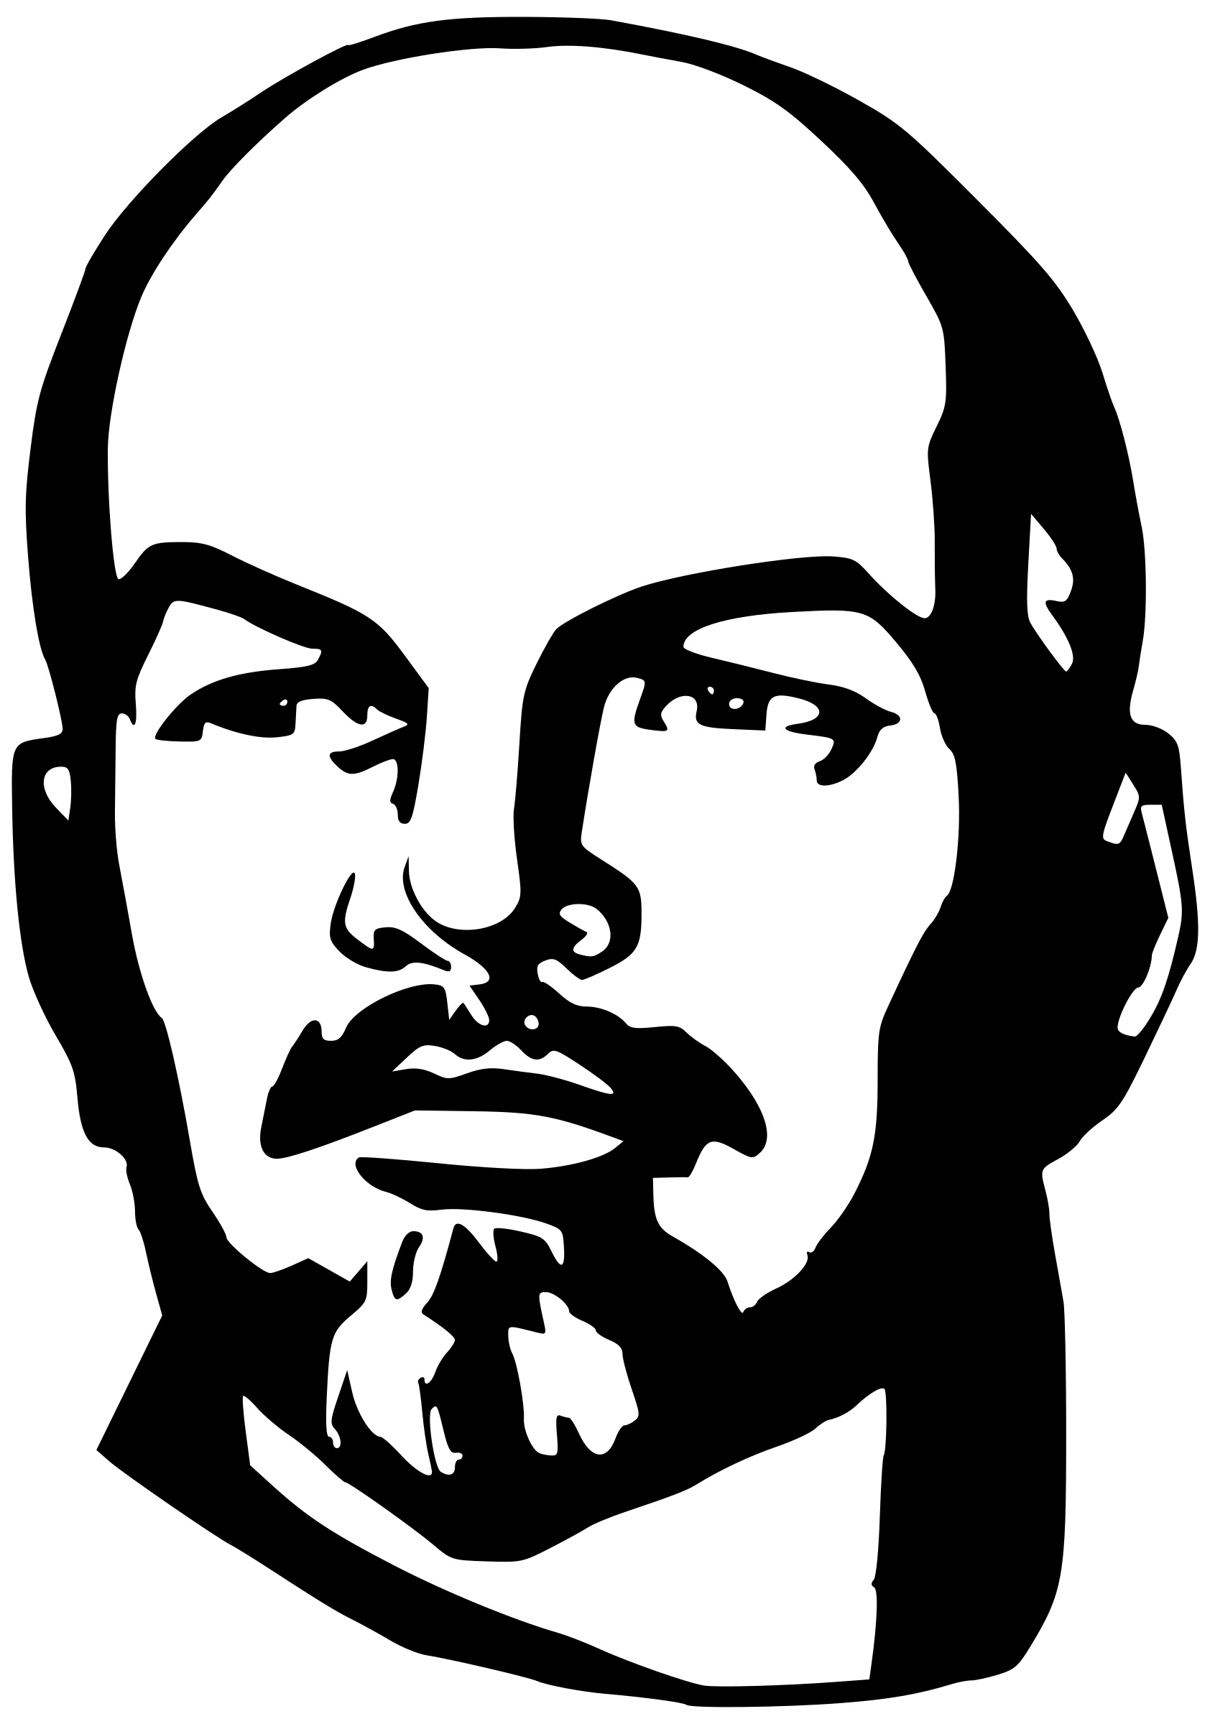
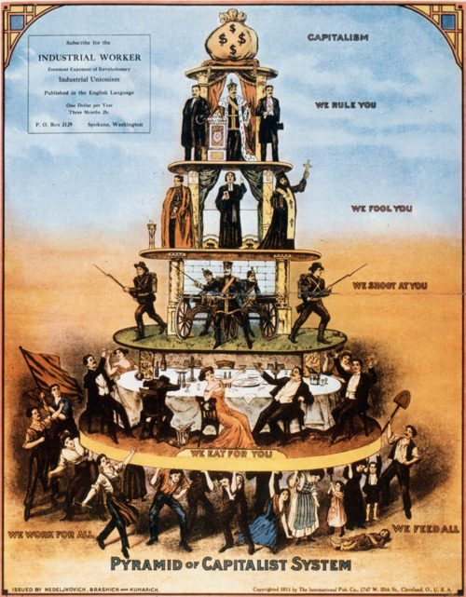
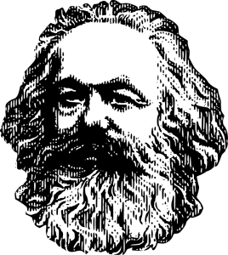
The Endless Class Struggle
Notes:
Another thing we learned is about the endless class struggle. The eternal battle between the proletariat and the economic elite. Throughout this game the government attempted to put forward measures to slow this economic inequality to no avail.

Slide 9








Unequal Distribution of Goods
Notes:
An issue that arose was the distribution of goods and hexes. Many of the proletariat did not receive the units they wanted and the elite received multiple of those units.

Slide 10
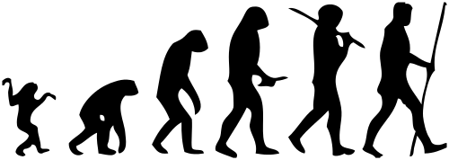
Human Nature
Notes:
I studied in this simulation human nature and people’s responses. There deepest instincts were that of individualism. People fought for themselves, not to better society but for selfish reasons. Every person fought for their political agenda not for what would best satisfy every person’s needs. People hoarded units, hoarded money and committed crimes to reach the best status they could regardless of the external cause

Slide 11
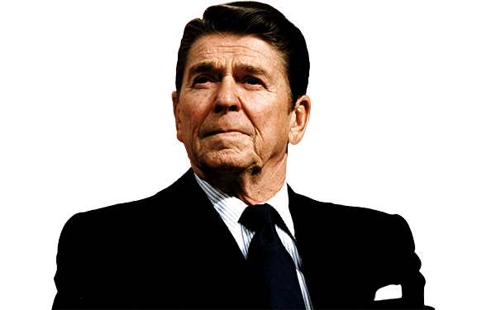

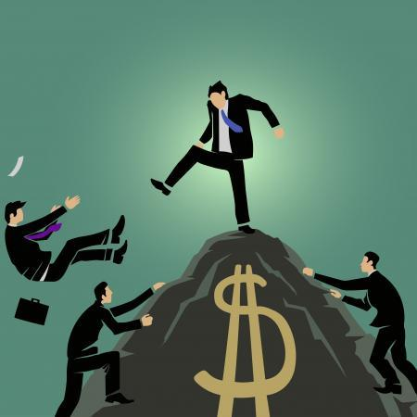
Individualism
Notes:
The ultimate issue causing all these problems is that of individualism. In the society it was person vs person, this is an inherent problem it is not sustainable.

Slide 12
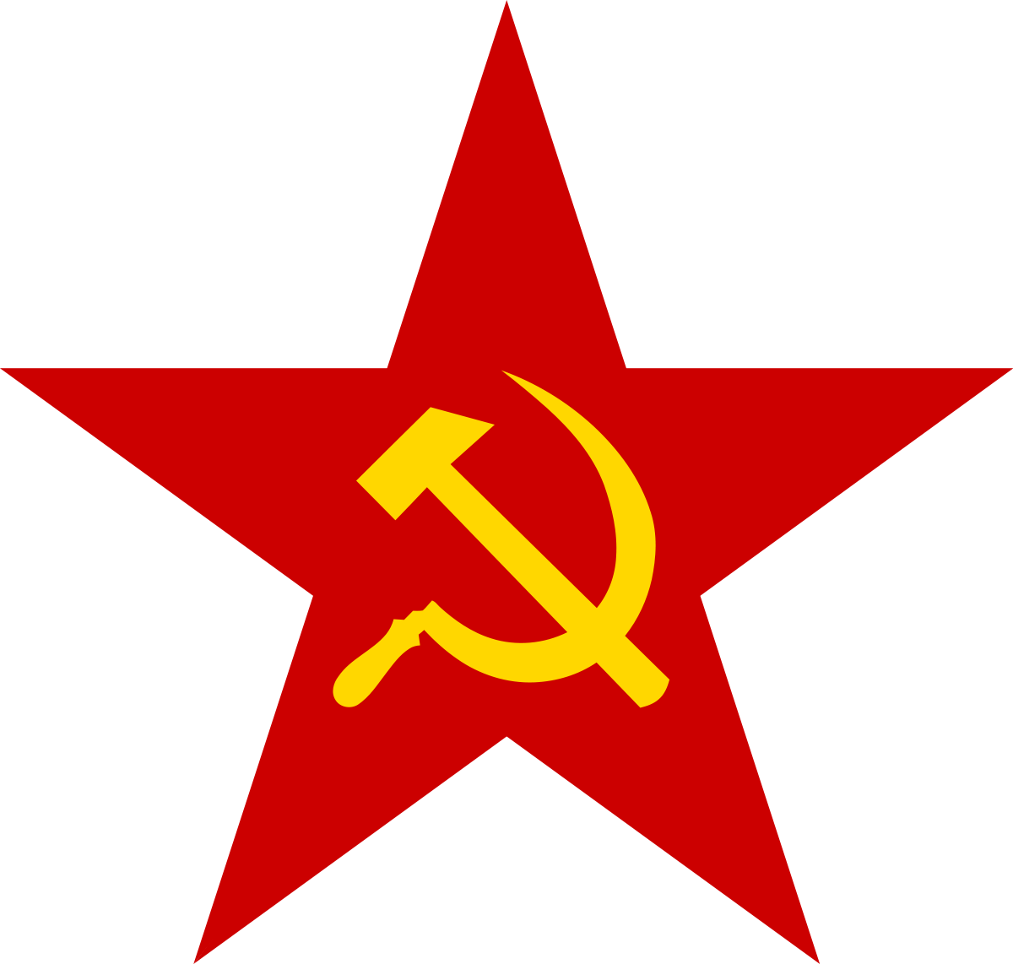

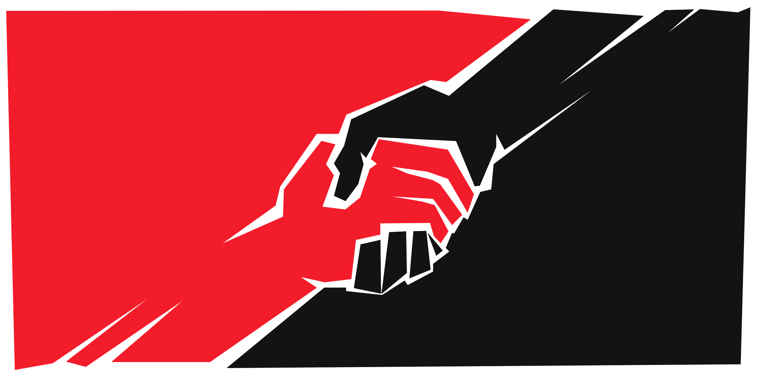
COLLECTIVISM
Notes:
The solution collectivism. Collectivism is when people work together as a society. This would remove the previous problems with class struggles and greed because this ideology works to establish a group rather than an individual.

Slide 13
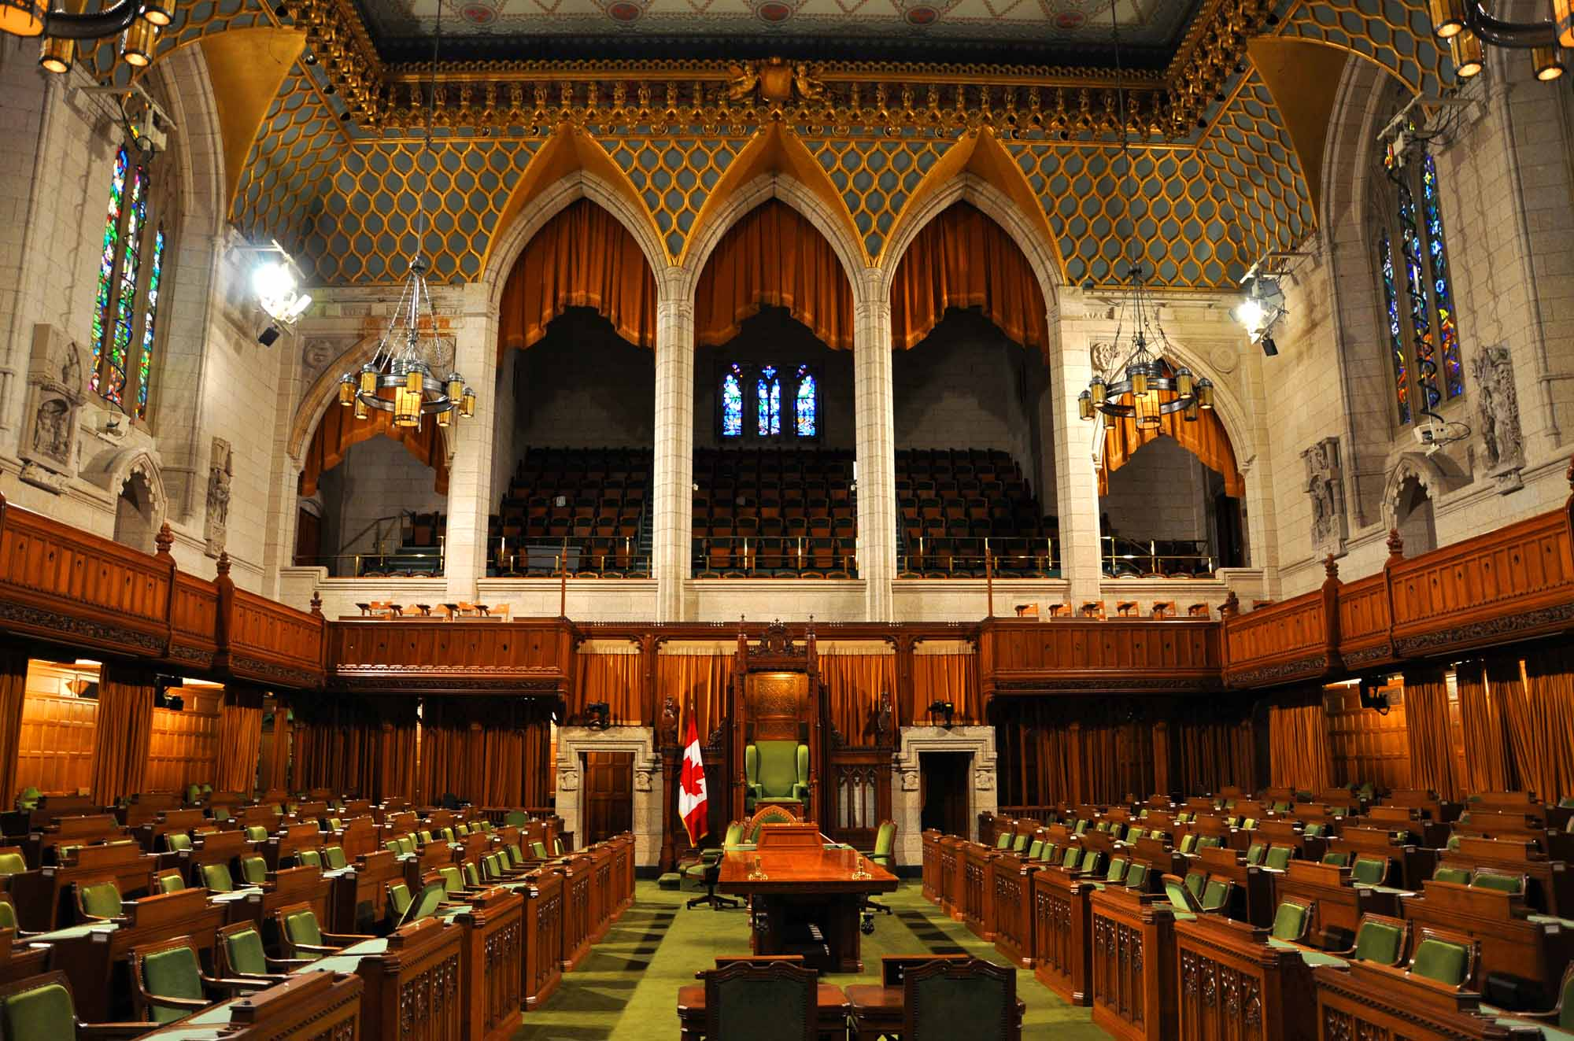
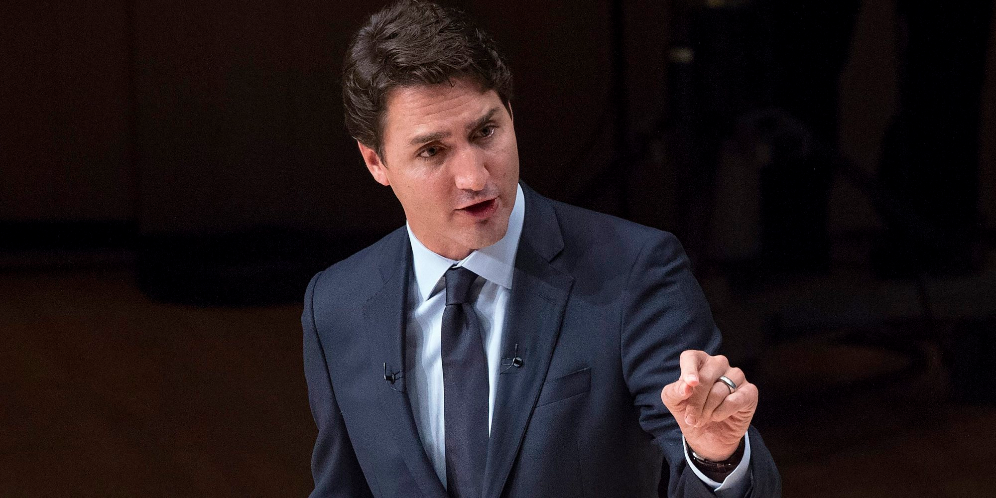
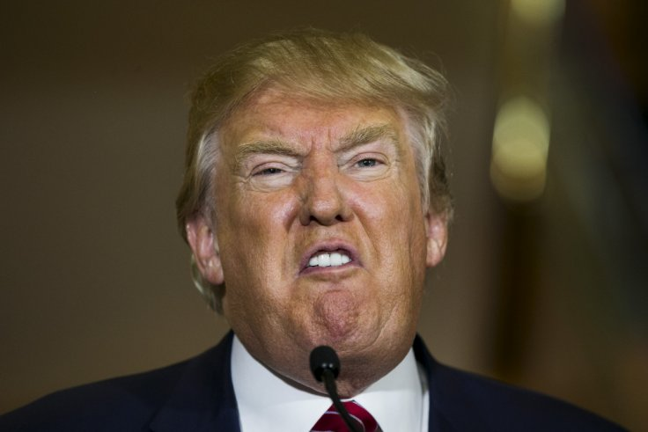
Waning trust in modern democracy
Notes:
What this simulation really gave me was this sense distrust and failure of the current democratic system. The only option left for the people was violent revolution and that was the only way change happened. It showed me the ineffectiveness of representative democracies and the potential for power abuse.

Slide 14
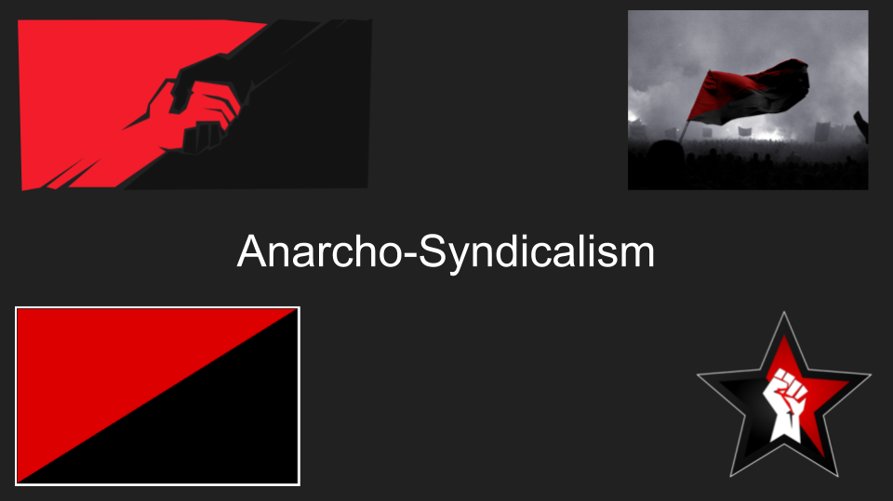
Notes:
The best solution and political system for civic mirror would be Anarcho-Syndicalism. Where decisions are made through direct democracy, money is abolished and the workers run the means of production. This would be the utopian society where every person could live freely. This fixes the problems with individualism and prevent power abuse since the people control the country directly.

Slide 15

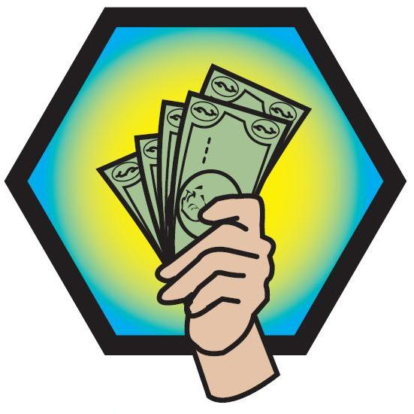
Conclusion
Notes:
Overall this has been a great game and I learned a lot not only about politics but also about human nature. Thank you for listening to my presentation.

